Slide 1


Passive Wi-Fi
Bryce Kellogg, Vamsi Talla,
Shyam Gollakota, Joshua R. Smith

Slide 2


Wi-Fi Alliance: 6.8 Billion Wi-Fi Devices

Slide 3

Wi-Fi is Extremely Power Hungry
Enterprise
PC
Mobile
IoT
Enterprise
PC
Mobile

Slide 4
Wi-Fi transmissions at 10,000x lower power
1,000x lower than BLE and ZigBee

Slide 5
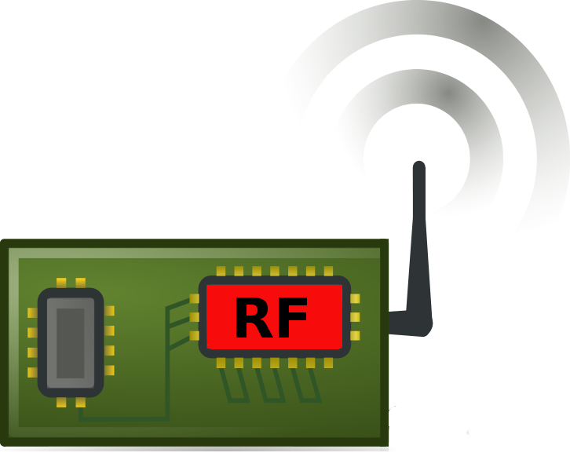
Why is Wi-Fi Power Consuming?
Power scaled with Moore’s law O(10 uW)
No such scaling O(100 mW)
Digital
(Baseband)
Analog
(RF)
Wi-Fi transmitter consumes 500 - 700 mW

Slide 6
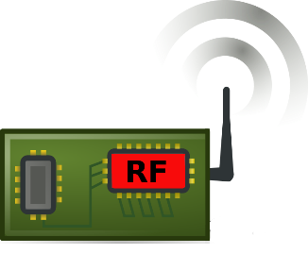
Our idea: Use only digital baseband
Passive Wi-Fi
Wi-Fi Device

Slide 7


Our idea: Use only digital baseband
Passive Wi-Fi
Single Plugged-in Device
Passive Device

Slide 8
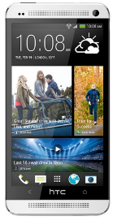
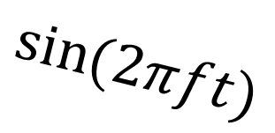
Generate Wi-Fi packets using reflections
Passive Wi-Fi
$$\sin{(2πft)}$$
Plugged-in Device
9
Passive Device
Wi-Fi Receiver
1, 2, 5.5 and 11 Mbps Wi-Fi @ 15-60 µW

Slide 9
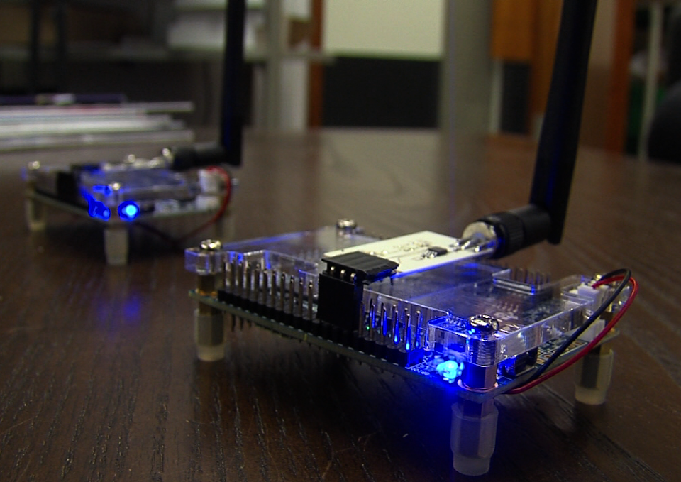
Passive Wi-Fi
Create first 802.11b transmissions via reflections
Design Passive Wi-Fi network stack to enable coexistence with regular Wi-Fi devices
Build and evaluate FPGA prototype and IC design

Slide 10
Live Demo

Slide 11
Outline
1) Generating 802.11b packets using reflections
2) Decoding the packets at regular Wi-Fi receiver
3) Designing a network stack for coexistence

Slide 12
Limited to square wave
Challenge: Don’t have capabilities of a radio
Backscatter
Legacy Wi-Fi Radio
DAC
RF
Can generate arbitrary signals

Slide 13
Our Solution: Leverage structure of 802.11b transmissions
802.11b supports four data rates
1 Mbps – Barker DSSS encoding with DBPSK
2 Mbps – Barker DSSS encoding with DQPSK
5.5, 11 Mbps – CCK encoding with DQPSK
Packet generation and encoding are binary operations
What we need: Modulation using square waves
DBPSK – 0° and 180° phase shift
DQPSK – 0°, 90°, 180° and 270° phase shift

Slide 14

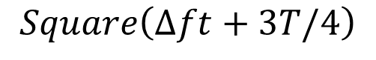
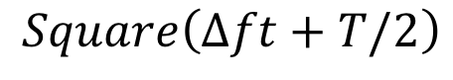
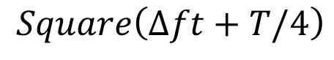
Our Solution: Leverage structure of 802.11b transmissions
Create phase shifts by time shifting the square wave
$$Square\left(Δft\right)$$
0°
$$Square\left(Δft+T/4\right)$$
T/4
90°
$$Square\left(Δft+T/2\right)$$
T/2
180°
$$Square\left(Δft+3T/4\right)$$
3T/4
270°

Slide 15
Outline
1) Generating 802.11b packets using reflections
2) Decoding the packets at regular Wi-Fi receiver
3) Designing a network stack for coexistence

Slide 16


Challenging: Strong interference from Plugged-in Device
Frequency
2.412 GHz
(channel 1)
2.437 GHz
(channel 6)
2.462 GHz
(channel 11)

Slide 17
Our Approach: Utilize Wi-Fi radios selective filtering
f
f-∆f
f+∆f
Frequency
2.412 GHz
(channel 1)
2.437 GHz
(channel 6)
2.462 GHz
(channel 11)
Create frequency shift using subcarrier modulation

Slide 18
Outline
1) Generating 802.11b packets using reflections
2) Decoding the packets at regular Wi-Fi receiver
3) Designing a network stack for coexistence

Slide 19
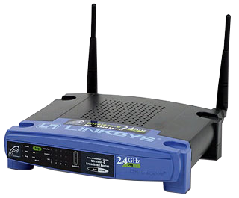
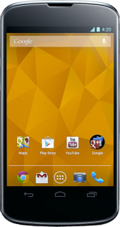
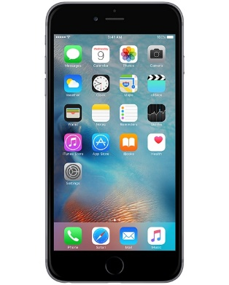

A Passive Wi-Fi Network

Slide 20
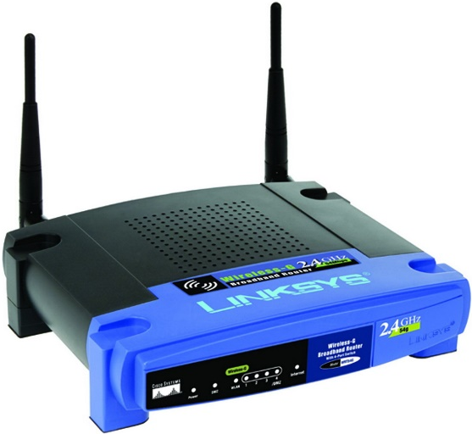
How Does Traditional Wi-Fi Coexist?
Carrier Sense
Transmit Packet
ACK
t
Receive operations are extremely power hungry

Slide 21

Delegate MAC to plugged-in device
Carrier Sense
Signaling Packet
Wi-Fi Packet
CW
ACK
ACK
Rx
Tx
Tx
Rx
Rx
Tx
t
t
Plugged-in Device
Wi-Fi Receiver
Signaling Packet
Wi-Fi Packet
Rx
Tx
t
Passive Device

Slide 22
Implementation
FPGA Prototype:
Altera Cyclone II
Custom backscatter switch
IC Implementation
Verilog baseband, RF switch, & custom PLL
TSMC 65nm LP Process
15 – 60 µW

Slide 23

Passive Wi-Fi Range Experiments
Plugged-in Device
d₁
d₂
Wi-Fi Receiver
Passive Device

Slide 24
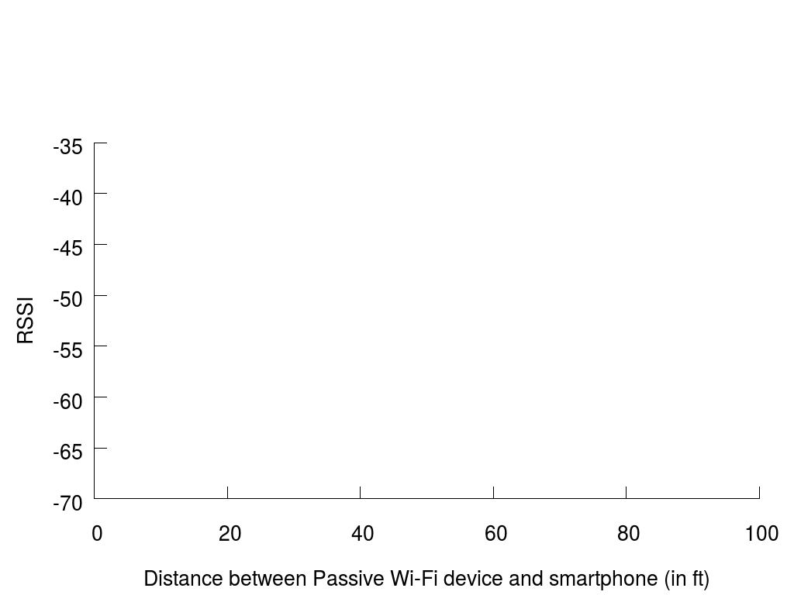
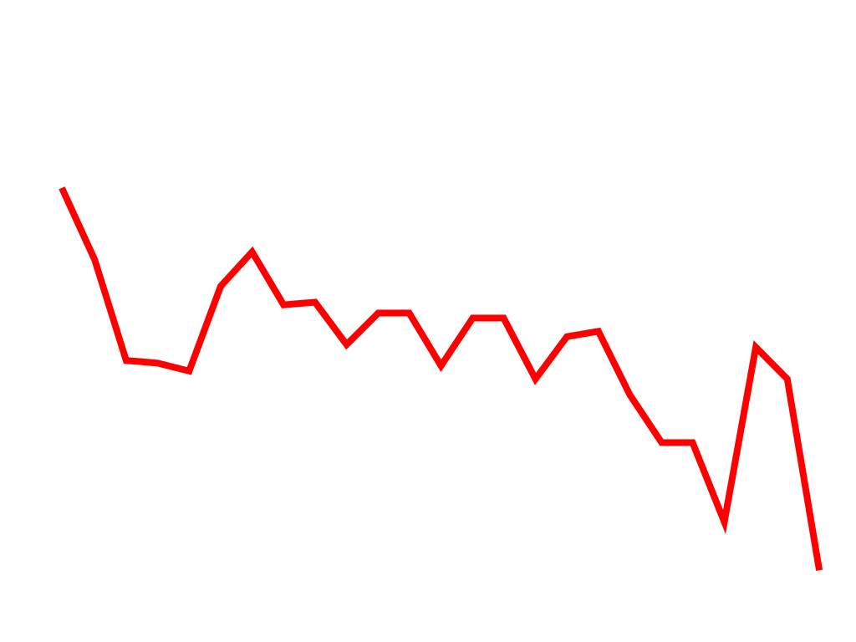
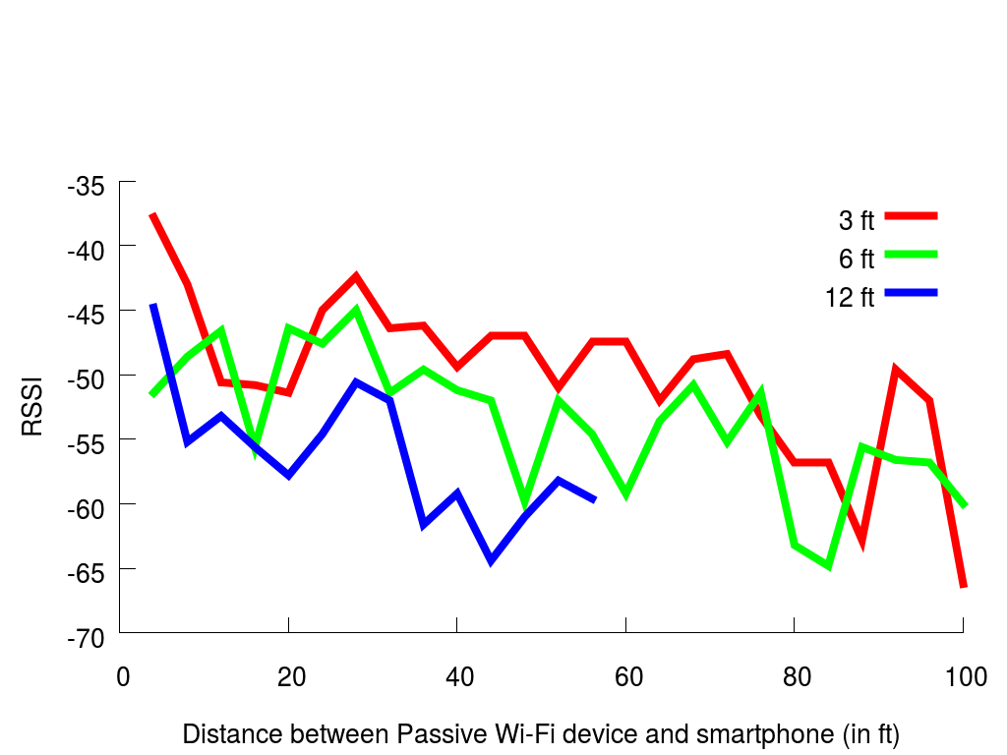


Passive Wi-Fi Range Experiments

Slide 25
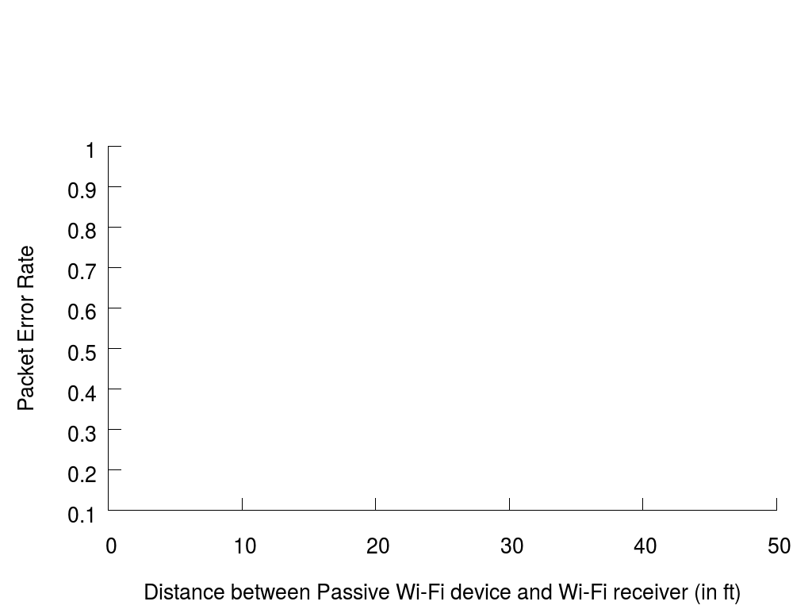
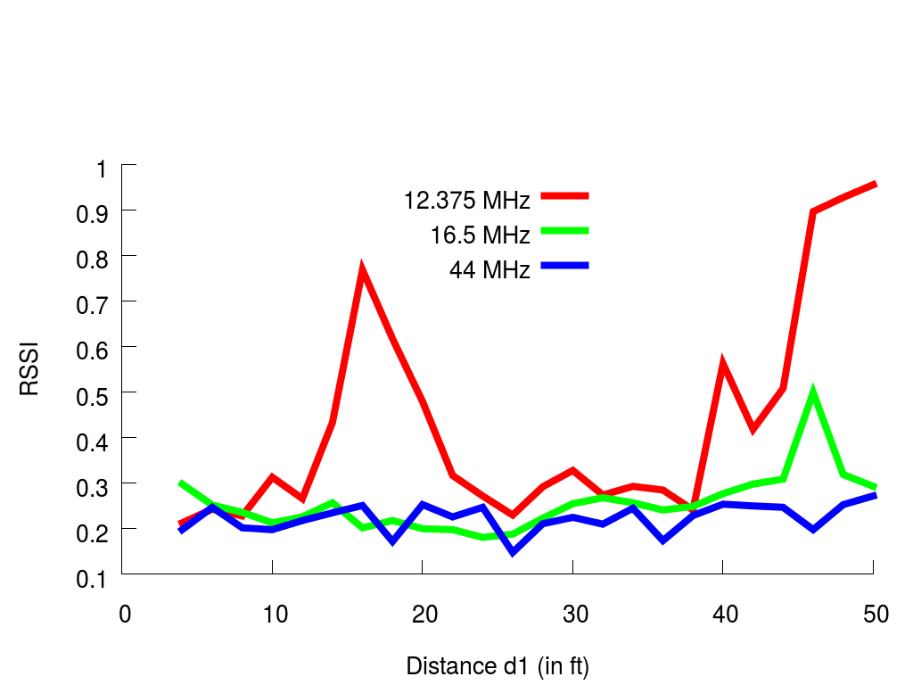
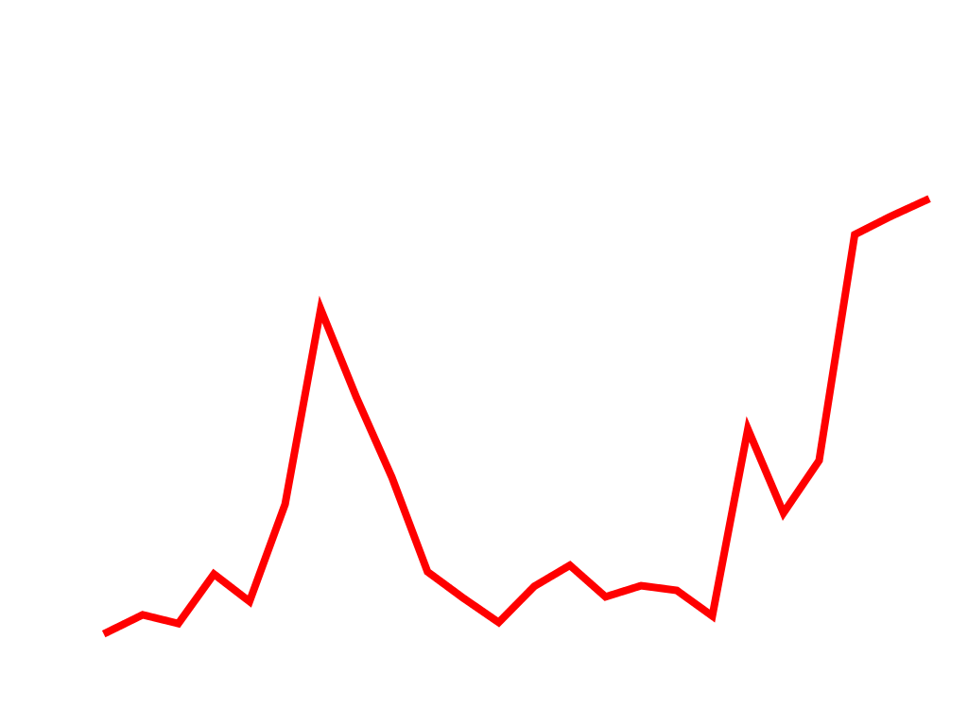

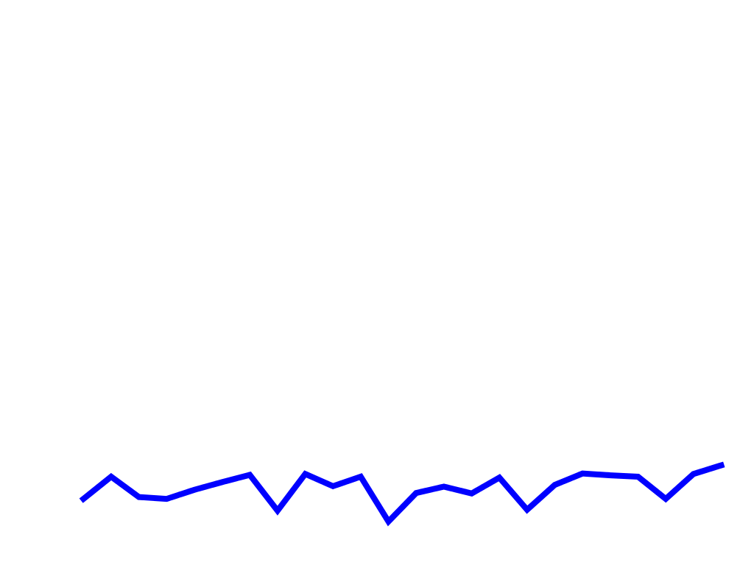
How much frequency shift is required?

Slide 26
Conclusions
We create Wi-Fi transmissions at 10,000x lower power than traditional Wi-Fi radios
Passive Wi-Fi enables connectivity for the next billion Wi-Fi devices
Learn more at passivewifi.cs.washington.edu

